Slide 1

“Social Networks on the Cloud”
Challenges at Kosmix / WalmartLabs
AnHai Doan
University of Wisconsin
@WalmartLabs
@WalmartLabs

Slide 2






Building a Big Social Network
Crowd sourcing
internal analysts, users, Mechanical Turks, others
IMDB
Musicbrainz
Wikipedia
…
Social Genome
Applications
Information extraction
Entity disambiguation
Entity merging
Schema matching
Event detection
Event monitoring
...
Shopycat
Highly scalable real-time infrastructure
File system RDBMS Hadoop Muppet
Slates Stream servers

Slide 3

Social Genome
all
places
people
Twitter users
FB users
actors
@melgibson @dsmith …
mel-gibson davesmith …
Angelia Jolie
Mel Gibson
tweet-about
the-same-as
events
@dsmith: Mel crashed.
Maserati is gone.
sports
celebrities
politics …
Gibson car crash
Egyptian uprising
capital-of
Egypt
Cairo
related-to
located-in
Tahrir
@far213: Tahrir is packed!

Slide 4
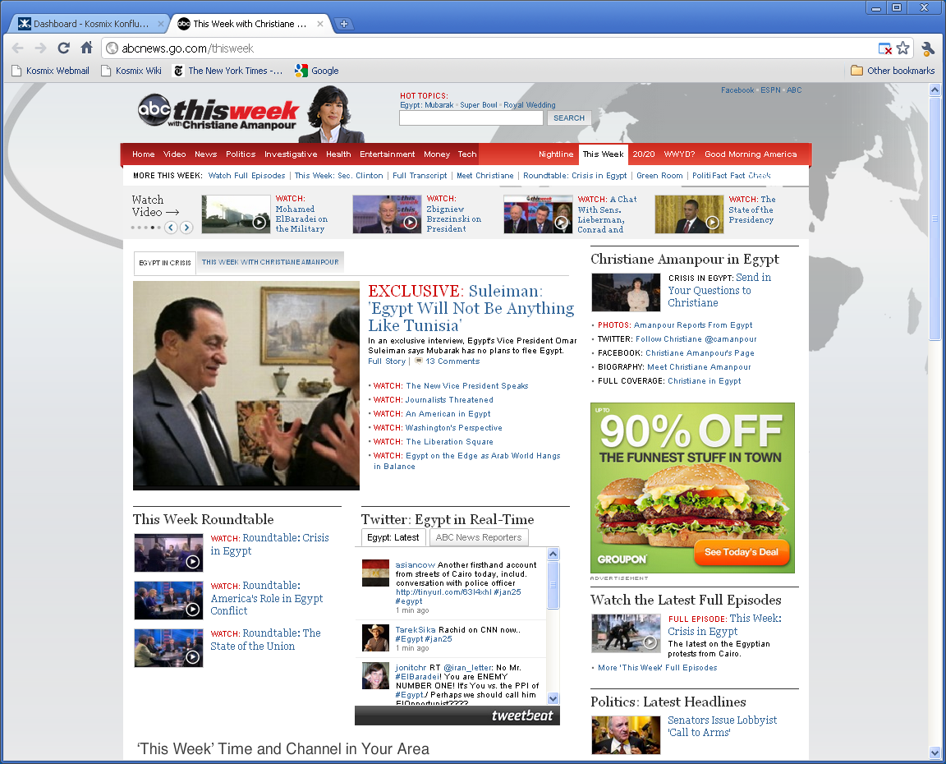
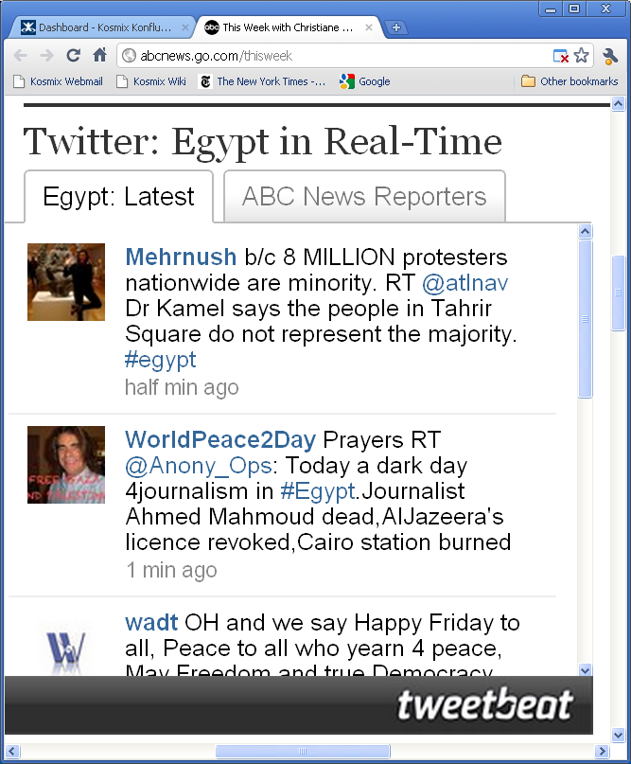

Slide 5
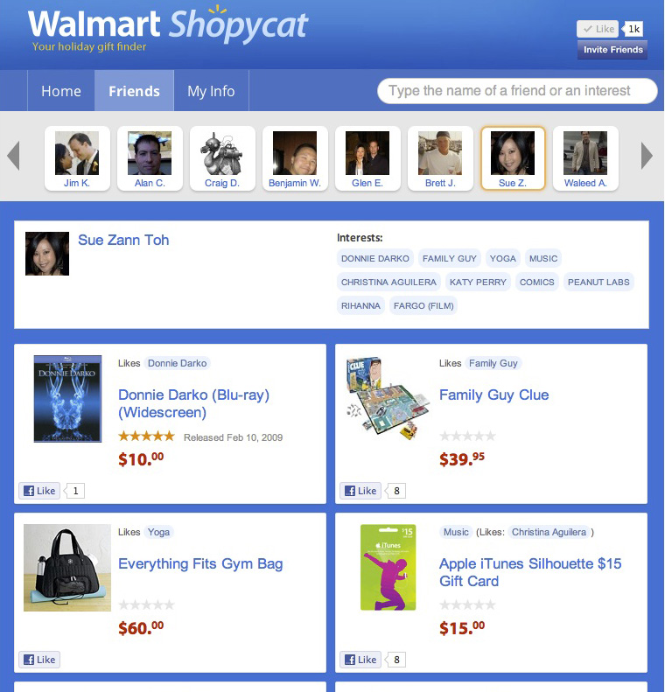
Examples of
Social Commerce Apps
Gift recommendation:
ShopyCat
  “I love salt!”
  “Your friend has
  just tweeted about
  the movie SALT.
  Would you like to buy
  something related for
  her birthday?”

Slide 6
Challenge 1: Data Integration and Mining
all
places
people
Twitter users
FB users
actors
@melgibson @dsmith …
mel-gibson davesmith …
Angelia Jolie
Mel Gibson
car, crash, maserati
the-same-as
tweet-about
events
@dsmith: Mel crashed.
Maserati is gone.
sports
celebrities
politics …
Gibson car crash
Egyptian uprising
capital-of
Egypt
Cairo
related-to
located-in
Tahrir
@far213: Tahrir is packed!

Slide 7
Challenge 2: Big and Fast Data
all
places
people
Twitter users
FB users
actors
@melgibson @dsmith …
mel-gibson davesmith …
Angelia Jolie
Mel Gibson
car, crash, maserati
the-same-as
tweet-about
events
@dsmith: Mel crashed.
Maserati is gone.
sports
celebrities
politics …
Gibson car crash
Egyptian uprising
capital-of
Egypt
Cairo
related-to
located-in
Tahrir
@far213: Tahrir is packed!

Slide 8
Challenge 2: Big and Fast Data
146 in past 5 mins
3267 in past 12 hours
Twitter firehose
Count tweets
related to Wael Ghonim
Egyptian
uprising
Justin Bieber
Charlie Sheen
Jordan unrest
North
China unrest
Tibet
West
Southeast

Slide 9
Challenge 3: Crowdsourcing
all
places
people
Twitter users
FB users
actors
@melgibson @dsmith …
mel-gibson davesmith …
Angelia Jolie
Mel Gibson
the-same-as
tweet-about
events
@dsmith: Mel crashed.
Maserati is gone.
sports
celebrities
politics …
Gibson car crash
Egyptian uprising
capital-of
Egypt
Cairo
related-to
located-in
Tahrir
@far213: Tahrir is packed!

Slide 10
Wrapping Up
Numerous social networks out there
  Built from raw data, using algorithms and humans
  Social genome @ WalmartLabs, DBLife, Google Scholar,
  network of biomed researchers, etc.
Key challenges
  Data integration: traditional Web data + social media
  Big and fast data
  Crowdsourcing

