Slide 1
Applications “Breakout Group”

Slide 2
Participants
Christos Faloutsos
Mario Nascimento (lead)
Alex Labrinidis (scribe)
Mohamed Sarwat
Cyrus Shahabi
Panos Ipeirotis
Cong Yu
Wang-Chien Lee
Jagan Sankaranarayanan.
Sameh Elnikety

Slide 3
Application Domains
Work better and live better (overarching theme)
Health
Security
Civil Services
Marketing
…

Slide 4
Specific Applications
Application Domain | Offline Analysis | Online Analysis
Health | Patient 0 identification, Immunization decisions, Insurance Fraud Detection | Patient/Elderly/ Environmental Monitoring
Security | Forensic Analysis, Guilt by association | Suspicious Co-occurrence
Civil Services (e.g., transportation) | Proactive Car-Pooling, Energy saving plans | Delay Notification, Emergency/Event Response.

Slide 5
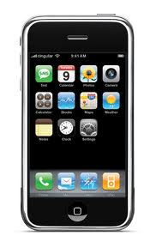
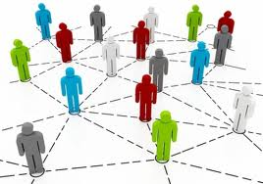
Research Framework/Needs
Data Stream Processing
Spatio-Temporal Processing
Graph Analysis
…

