Slide 1
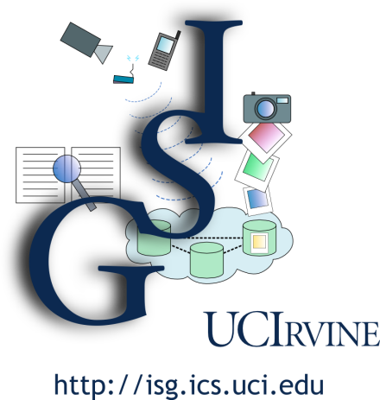
O Sole Mio: On the Orographic implications of Social, Local, Event, and Mobile Information Observing
Michael J. Carey
Information Systems Group
UC Irvine
(2/23/2012)

Slide 2
My Qualifications

Slide 3
Here’s the Plan
Oro-what-ic…???
Shaping the Cloud (for social meets mobile)
Some statistics and Workshop Day 1 reflections
State of the “Cloud” infrastructure landscape today
A shameless plug for UCI research
Quick overview of the ASTERIX project
Yahoo! tries teaching an old dog to speak Datalog
Meanwhile, elsewhere at UCI, in Social Sciences…
Opportunities and possible recommendations
What should we recommend to NSF?
How might we better leverage one another?

Slide 4
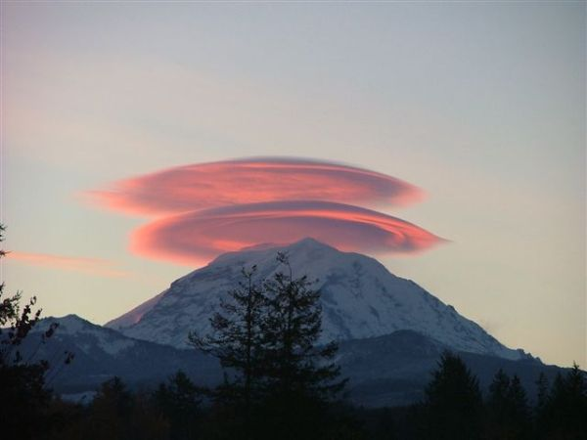
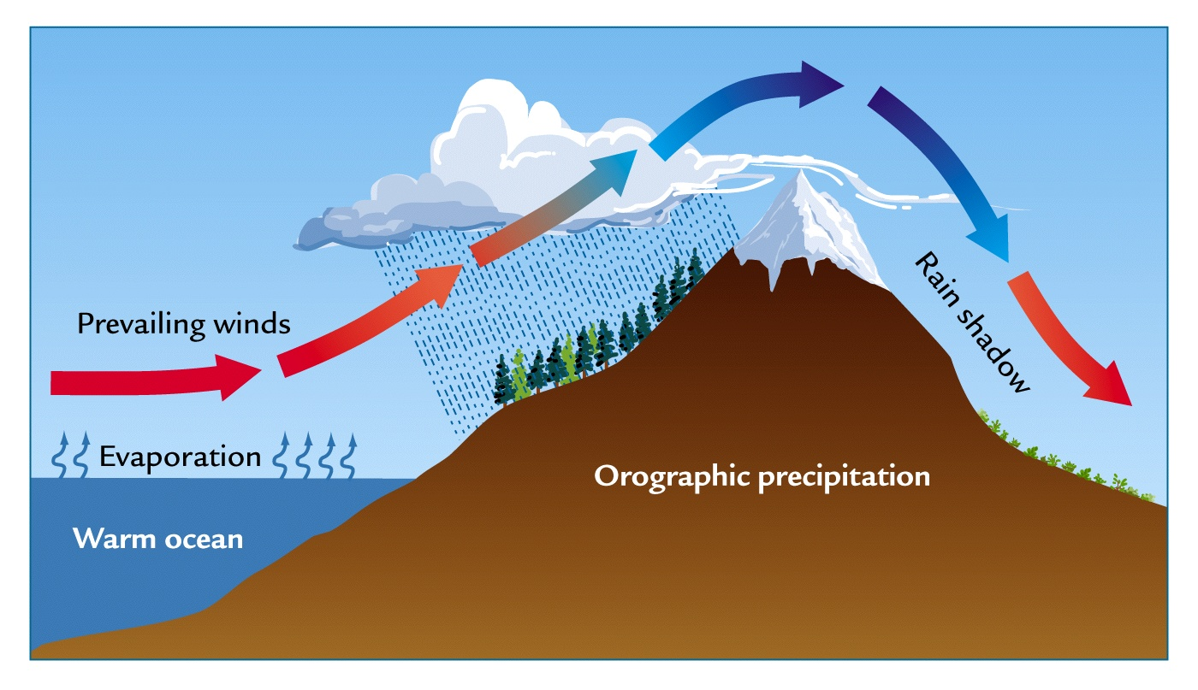
Orographic Clouds
According to Wikipedia:
“Orographic lift occurs when an air mass is forced from a low elevation to a higher elevation as it moves over rising terrain. As the air mass gains altitude it quickly cools down adiabatically, which can raise the relative humidity to 100% and create clouds and, under the right conditions, precipitation.”

Slide 5
Our Orographic Forces

Slide 6
Information-Rich Times → Big Data
Databases have long been central to our existence, but now digital info, transactions, and connectedness are everywhere…
E-commerce: > $100B annually in retail sales in the US
In 2009, avg # of e-mails/person was 110 (biz) and 45 (avg user)
Print media suffering, news portals and blogs thriving
Social networks have truly exploded in popularity
End of 2009 Facebook statistics:
> 350 million active users, > 55 million status updates/day
> 3.5 billion pieces of content/week and > 3.5 million events/month
Facebook two years later:
> 845 million monthly active users (425 million mobile)
> 8 billion messages/day
Twitter and similar services are also hugely popular
March 2010: 50 million Tweets/day
One year later: 140 million Tweets/day

Slide 7
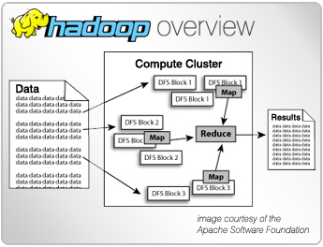
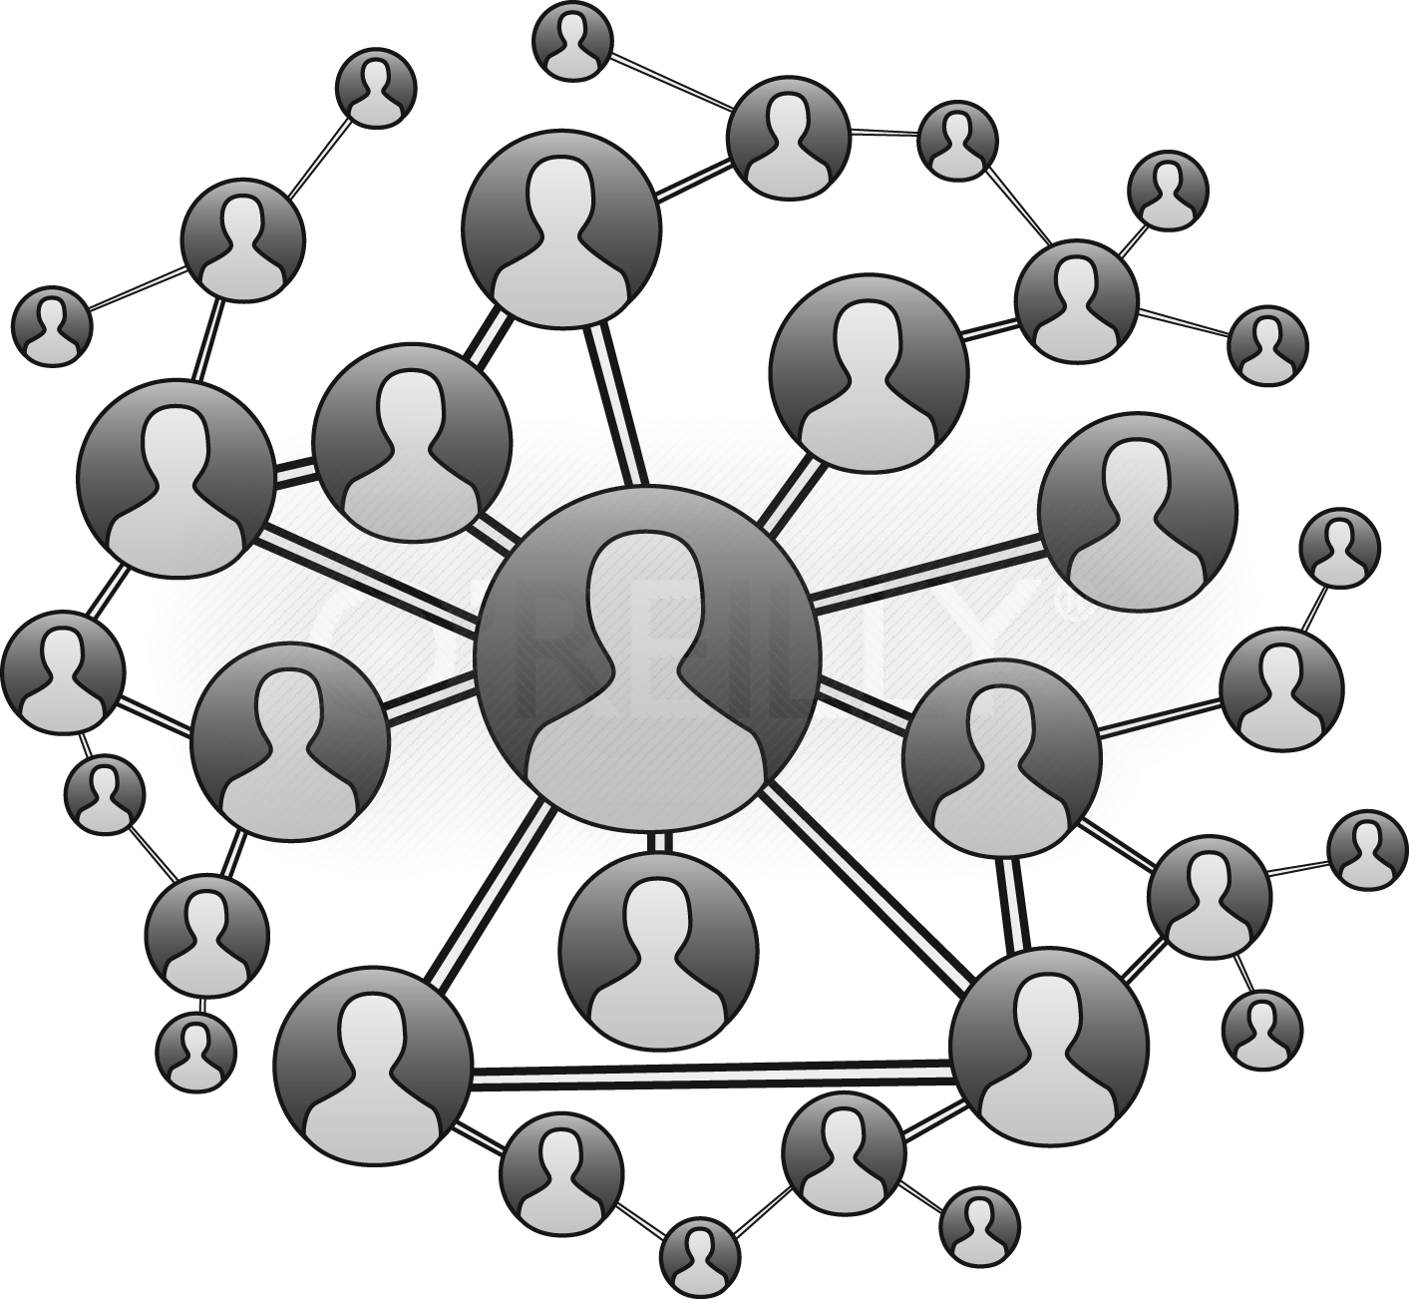
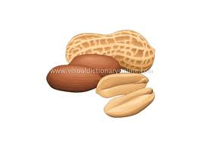
Day One Summary: Cloud Data Infrastructure

Slide 8
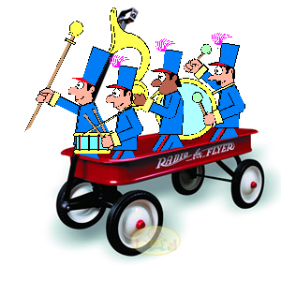
Today: Cloud Data Bandwagons
MapReduce and Hadoop
“Parallel programming for dummies”
But now Pig, Scope, Jaql, Hive, …
MapReduce is the new runtime!
GFS and HDFS
Scalable, self-managed, Really Big Files
But now BigTable, HBase, …
HDFS is the new file storage!
Key-value stores
All charter members of the “NoSQL movement”
Includes Dynamo, BigTable, PNUTS, HBase, Cassandra, …
These are the new record managers!

Slide 9
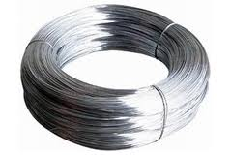
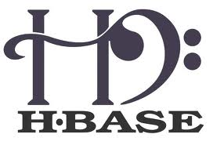
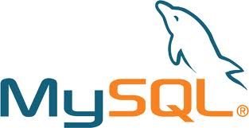
Current Best Practices
NOTE: The bar is at a historic low right now.
This is an exciting opportunity…!

Slide 10
Let’s Approach This Stuff “Right”!
What’s happened here?
The OS/DS folks out-scaled the (napping) DB folks
Are these the sacred new foundation? No!
IMO: Identify key lessons, then do it “right”
Cheap open-source S/W on commodity H/W
Non-monolithic software components
Equal opportunity data access (external sources)
Tolerant of flexible / nested / absent schemas
Little DBA-type work required (and no pagers)
Fault-tolerant (long) query execution

Slide 11
The ASTERIX Project at UCI (Joint with UCR and UCSD)
Semistructured
Data Management
Parallel
Database Systems
Data-Intensive
Computing

Slide 12
So What If We’d Meant To Do This?
What is the “right” basis for analyzing and managing the data of the future?
Runtime layer(s) and division of labor?
Storage and data distribution layers?
Explore how to build new information management systems for the cloud that…
Seamlessly support external data access
Execute queries in the face of partial failures
Scale to thousands of nodes (and beyond)
Don’t require five-star wizard administrators
Support data types and features for Web data

Slide 13
ASTERIX Objectives
Build a scalable information management platform
Large commodity clusters for handling mass quantities of semistructured data
Openly layered for selective reuse by others
Shared with the community via open source (2012)
Conduct timely information systems research
Large-scale query processing and workload management
Highly scalable storage and index management
Fuzzy matching, spatial data, date/time data, in parallel
Novel support for “fast data” (both in and out)
Train next generation of “Big Data” researchers and software engineers in the process

Slide 14
ASTERIX System Overview
(ADM = ASTERIX Data Model;
AQL = ASTERIX Query Language)

Slide 15
ASTERIX Data Model (ADM)
create dataverse LittleTwitterDemo;
create type TweetMessageType as open {
tweetid: string,
user: {
screen-name: string,
lang: string,
friends_count: int32,
statuses_count: int32,
name: string,
followers_count: int32
},
sender-location: point?,
send-time: datetime,
referred-topics: {{ string }},
message-text: string
};
create dataset TweetMessages(TweetMessageType)
partitioned by key tweetid;
Highlights:
JSON + (ODMG – methods) ≠ XML
Usual primitive types (ints, floats, string, boolean, date, time, datetime, …)
Spatial types
Records, lists, bags
Open vs. closed types
External data sets and datafeeds

Slide 16
ASTERIX Query Language (AQL)
Ex: List the topics being Tweeted about, along with their associated Tweet counts, in Cloud-related Tweets:
for $tweet in dataset('TweetMessages')
where some $topic in $tweet.referred-topics
satisfies contains($topic, “Cloud”)
for $topic in $tweet.referred-topics
group by $topic with $tweet
return {
"topic": $topic,
"count": count($tweet)
}
Highlights:
Lots of other features (no time!)
Fuzzy matching (~= operator)
Spatial predicates and aggregation
Plans for windowing and continuous query support
Note: A group of smart researchers and practitioners designed XQuery for complex, semistructured data – we chose to start by standing on their shoulders

Slide 17
Algebricks (and the ASTERIX Stack)
Set of (data model agnostic) logical operations
Set of physical operations
Rewrite rule framework
Generally applicable rewrite rules (including parallelism)
Metadata provider API (catalog info for Algebricks)
Mapping of physical operations to Hyracks operators

Slide 18
ASTERIX and Hyracks

Slide 19
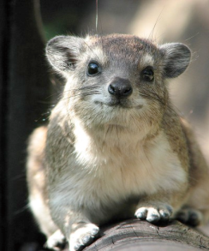
Hyracks In a Nutshell
Partitioned-parallel platform for data-intensive computing
Job = dataflow DAG of operators and connectors
Operators consume/produce partitions of data
Connectors repartition/route data between operators
Hyracks vs. the “competition”
Based on time-tested parallel database principles
vs. Hadoop: More flexible model and less “pessimistic”
vs. Dryad: Supports data as a first-class citizen

Slide 20
Hadoop Compatibility Layer
Goal:
Run Hadoop jobs unchanged on top of Hyracks
How:
Client-side library converts a Hadoop job spec into an equivalent Hyracks job spec
Hyracks has operators to interact with HDFS
Dcache provides distributed cache functionality

Slide 21
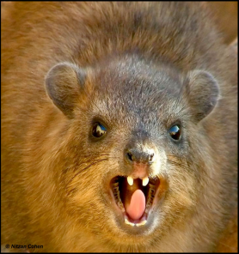
Hyracks Performance (On a cluster with 40 cores & 40 disks)
K-means (on Hadoop compatibility layer)
DSS-style query execution (TPC-H-based example)
(Faster ☺)

Slide 22
Machine Learning in ScalOps, A higher order cloud computing language
ASTERIX Outside the UCI Ivory Tower
Markus Weimer
Tyson Condie
Raghu Ramakrishnan

Slide 23
Applied large scale ML requires …
A Relational Algebra
Join, Filter, Group By, …
For feature and label extraction
Iterative computation
Loops over data
Incremental model updates
Scalability / High Performance
Client code most not be specific to the data set size or cluster configuration
Optimize for optimal performance on any hardware configuration (e.g. multi-rack, multi-core, cached data)
Spark
Pregel
One-Offs
?

Slide 24
Example Decisions to be made I
def train(xy: Queryable[Example],
g: (Example, Vector) => Vector) = {
loop(zeros(1000), 0 until 1000) {
w => w - xy.map(x => g(x, w)).reduce(_+_)
}
}

Slide 25
Example Decisions to be made II
Scheduling
Caching
def train(xy: Queryable[Example],
g: (Example, Vector) => Vector) = {
loop(zeros(1000), 0 until 1000) {
w => w - xy.map(x => g(x, w)).reduce(_+_)
}
}
Prefetching
Checkpoints
Notes:
Lots of decisions are on the programmer when writing even the simplest of parallel ML algorithms

Slide 26
ScalOps prescription: Automation
ScalOps
Logical Query Plan
Relational Algebra
Looping
Inline UDFs
Physical Plan
Optimized
Logical Query Plan
(Currently using Hyracks for physical query plans and runtime, and looking to move to Algebricks with extensions to support Datalog-style recursion. Tested on ~1500 core clusters so far.)
Runtime

Slide 27
ASTERIX Summary
Semistructured
Data Management
Parallel Database Systems
Data-Intensive
Computing
Our approach: Ask not what cloud software can do for you, but what you can do for cloud software…!
We’re asking exactly that in our work at UCI:
ASTERIX: Parallel semistructured data management platform
Algebricks: Data-intensive computing algebra and optimizer
Hyracks: Data-intensive computing runtime

Slide 28
Partial ASTERIX Cast List
Semistructured
Data Management
Parallel Database Systems
Data-Intensive
Computing
Faculty and research scientists
UCI: Michael Carey, Chen Li; Vinayak Borkar, Nicola Onose (Google)
UCSD/UCR: Alin Deutsch, Yannis Papakonstantinou, Vassilis Tsotras
PhD students
UCI: Rares Vernica (HP Labs), Alex Behm, Raman Grover, Yingyi Bu, Yassar Altowim, Hotham Altwaijry, Sattam Alsubaiee, Pouria Pirzadeh, Zachary Heilbron, Young-Seok Kim
UCSD/UCR: Nathan Bales, Jarod Wen
MS students
UCI: Guangqiang Li, Vandana Ayyalasomayajula, Siripen Pongpaichet, Ching-Wei Huang, Manish Honnatti, Deepak Agrawal
BS students
UCI: Roman Vorobyov, Dustin Lakin

Slide 29
For More ASTERIX Info
Semistructured
Data Management
Parallel Database Systems
Data-Intensive
Computing
ASTERIX:
http://asterix.ics.uci.edu
Hyracks (early open source version):
http://code.google.com/p/hyracks
Algebricks:
Coming soon to a cluster near you (☺)
And please:
Contact us if you think you might want to try out any/all of our layers in an “alpha” or “beta” trial!

Slide 30
ASTERIX Status
Semistructured
Data Management
Parallel Database Systems
Data-Intensive
Computing
Current status (early 2012):
Lessons from a fuzzy join case study (Student Rares V. scarred for life)
Hyracks 0.1.8 was “released” (In open source, at Google Code)
AQL is up and running – in parallel (Both DDL and DML)
Also implemented Hivesterix (Model-neutral QP: Algebricks)
Storage work underway (LSM) (ADM, B+ trees, R-trees, text, …)
Fuzzy joins and spatial support (Data types; indexing underway)
HyracksRQ and ScalOps (Pregel-like layer for Hyracks)
Aiming for an open source release of some sort at the end of the initial 3-year funding period (Fall 2012)

Slide 31
Challenges for NSF Research(ers)
Systems and scale challenges
Access to large clusters (esp. for systems work)
Access to large cluster workloads
Data and scale challenges
Content under lock and key at Facebook, Twitter, Google, and friends (privacy and $ factors)
Algorithms sensitive to content and to how their outputs change users’ next moves
Effort and completeness challenges
Building something “real” is different than writing papers with graphs from simulations
Not everyone has the required time, resources, or desire (exceptions: DBLife, Spark, Musubi, TransDec, ASTERIX, …)
Requires additional funding (tailored and timed for it)

Slide 32
So What Might We Recommend?
Encourage us to work with “real customers”
Ex: We’ve just opened an ASTERIX dialog with the “HEROIC” project team in Social Sciences at UCI – they do cool stuff!
Gathered > 600M Tweets and >1B social ties and associated data
Studying Twitter-based communication (social media impact) related to hazards/emergencies for individuals and agencies
Testing applicability of classic social science theories in this setting
Enable and encourage us to work together
Ex: Could we, through NSF, create a “SciLife” social network from DBLife++ running on top of (e.g.) ASTERIX or equivalent?
Add new alternative components/algorithms to bottom
Add new entity resolvers and recommenders to middle
Build new UIs and mobile apps on top
Stop measuring impact (us too!) based on acres of PDF trees cleared or related metrics like H-Index

