Slide 1
Infrastructure Group
Source: Wikipedia (Clouds)

Slide 2
Participants
Divyakant Agrawal
Michael J. Carey
Panos K. Chrysanthis
Anhai Doan (Scribe-analog)
Yuxiong He
Le Grunewald
Justin J. Levandoski (Scribe-digital)
Jimmy Lin (dictator leader)
Vahab Mirrokni
Shashi Shekhar

Slide 3
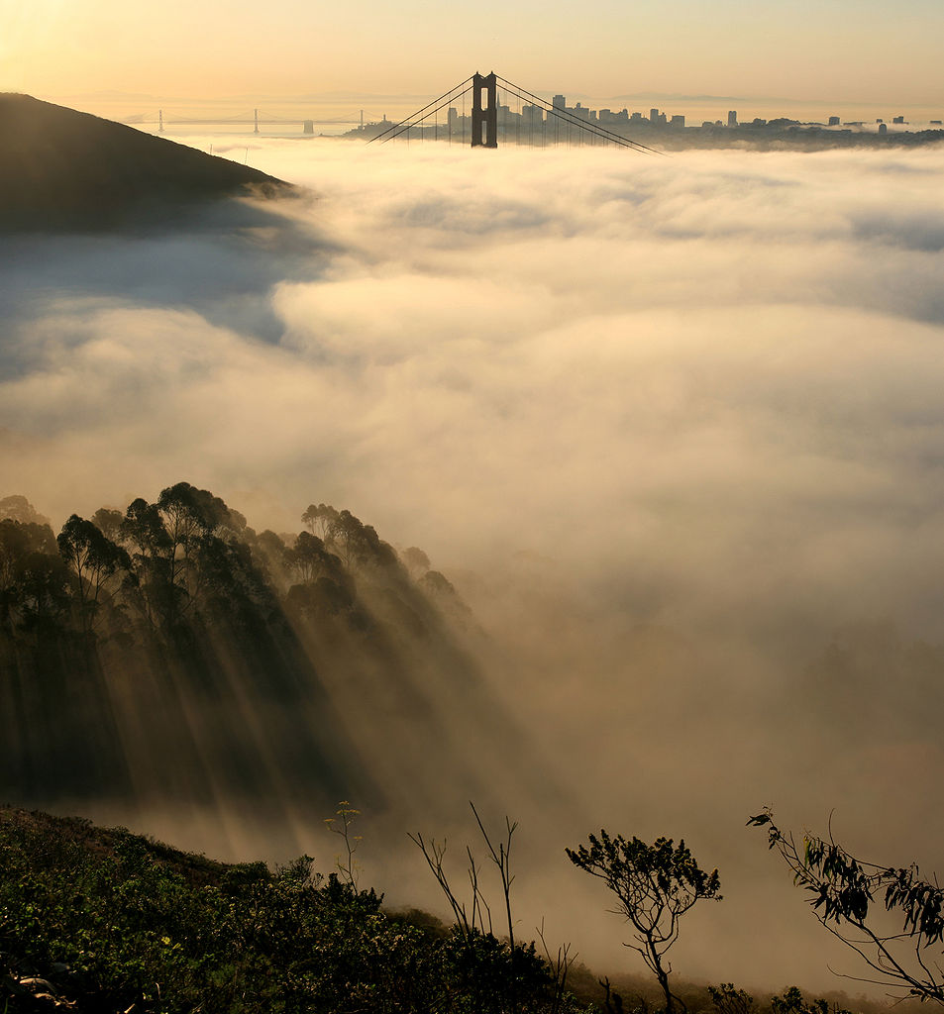
fog computing

Slide 4
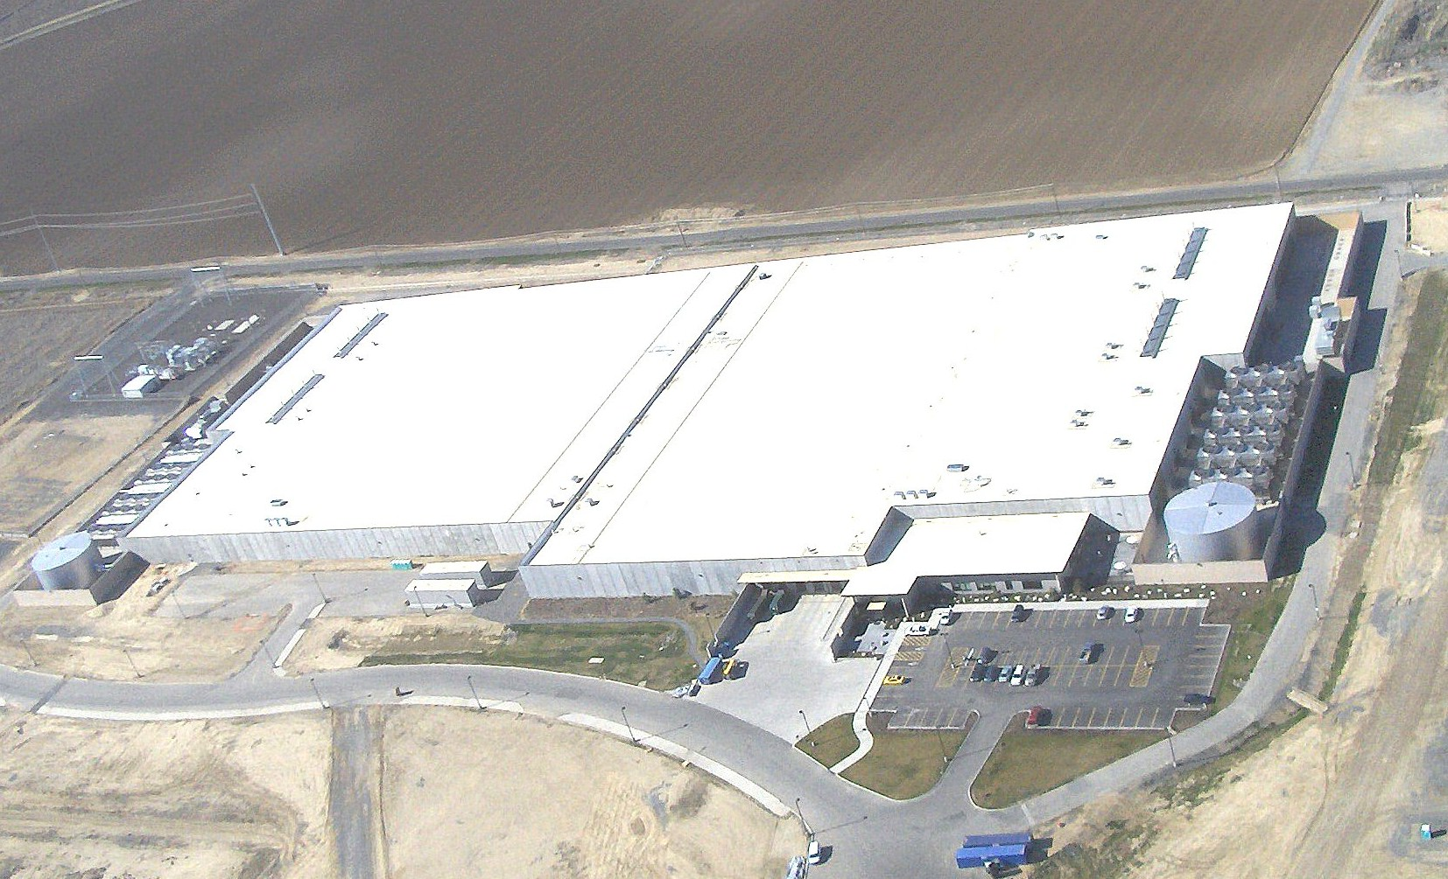
datacenters
Source: Microsoft

Slide 5
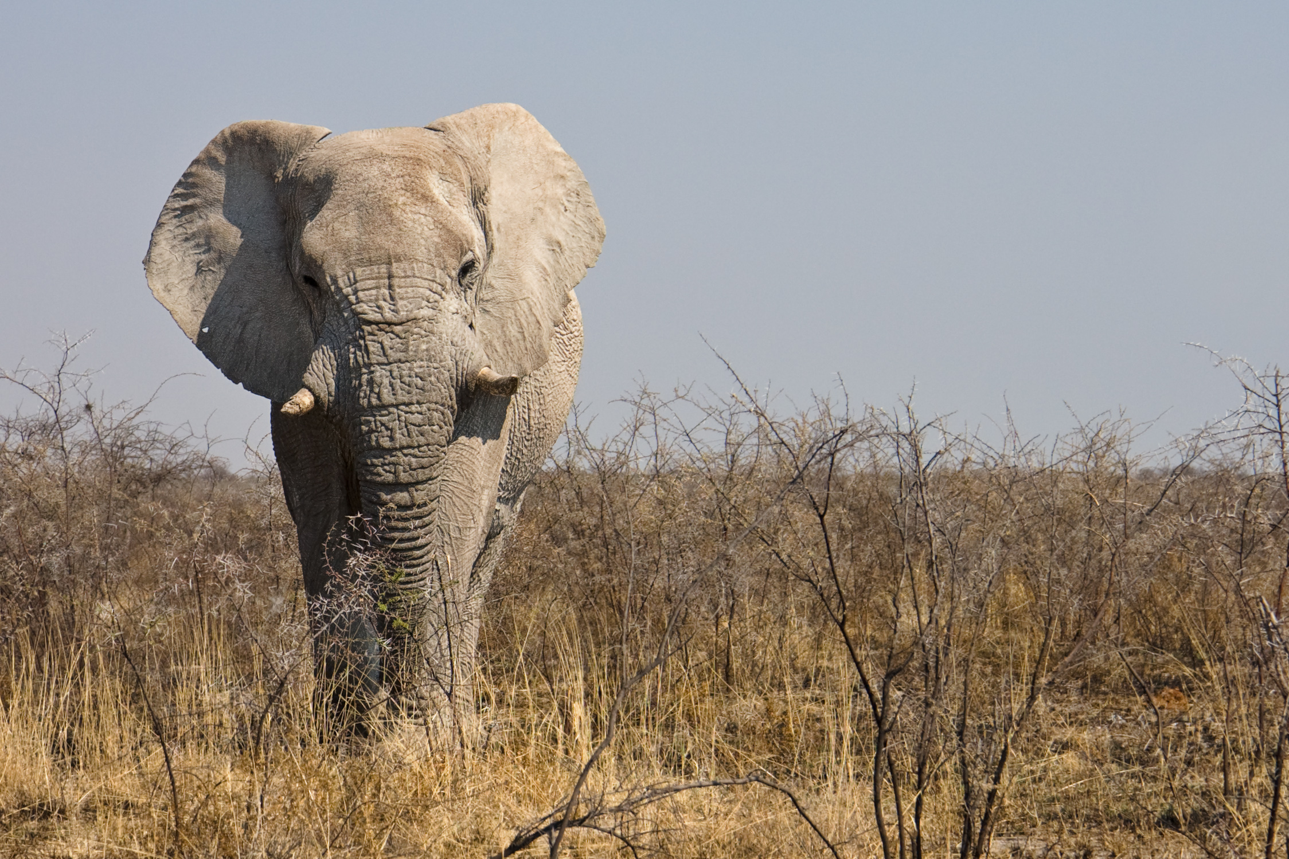
big data

Slide 6
fast data

Slide 7
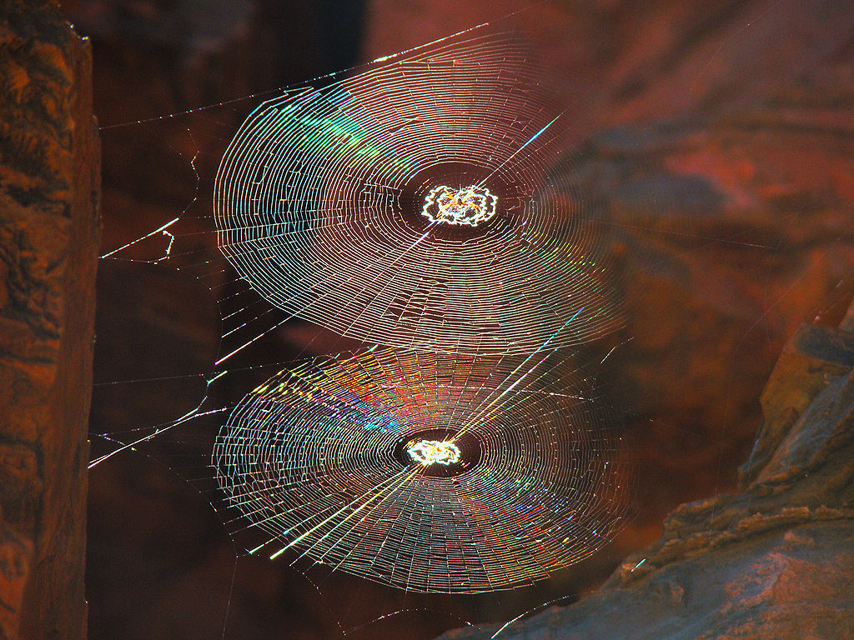
graph data

Slide 8
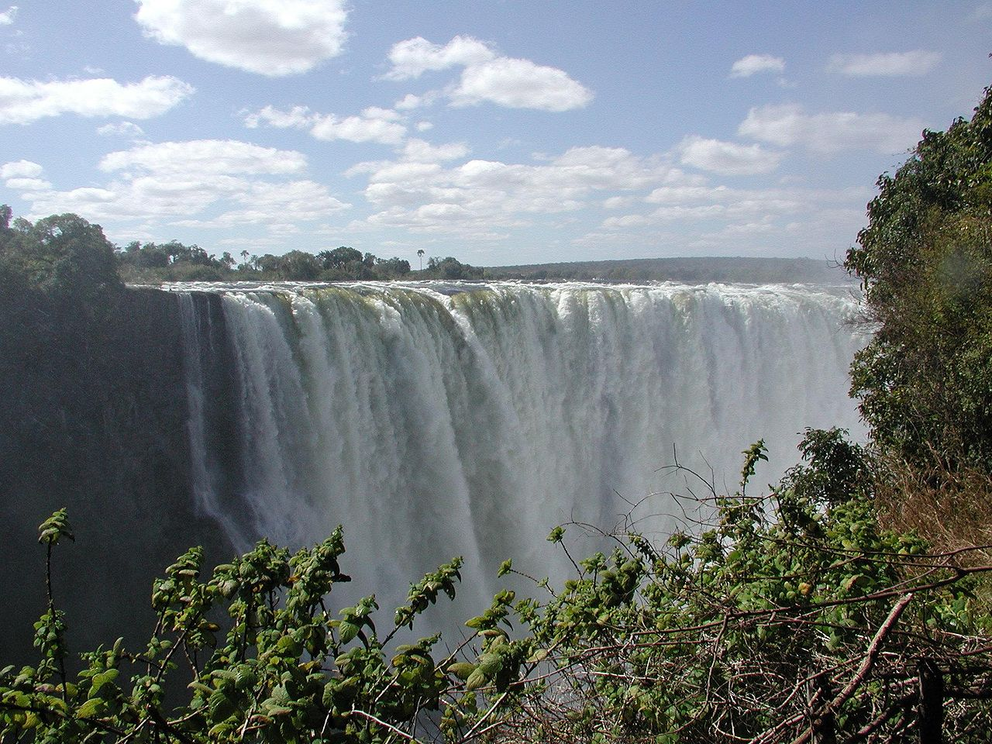
stream data

Slide 9
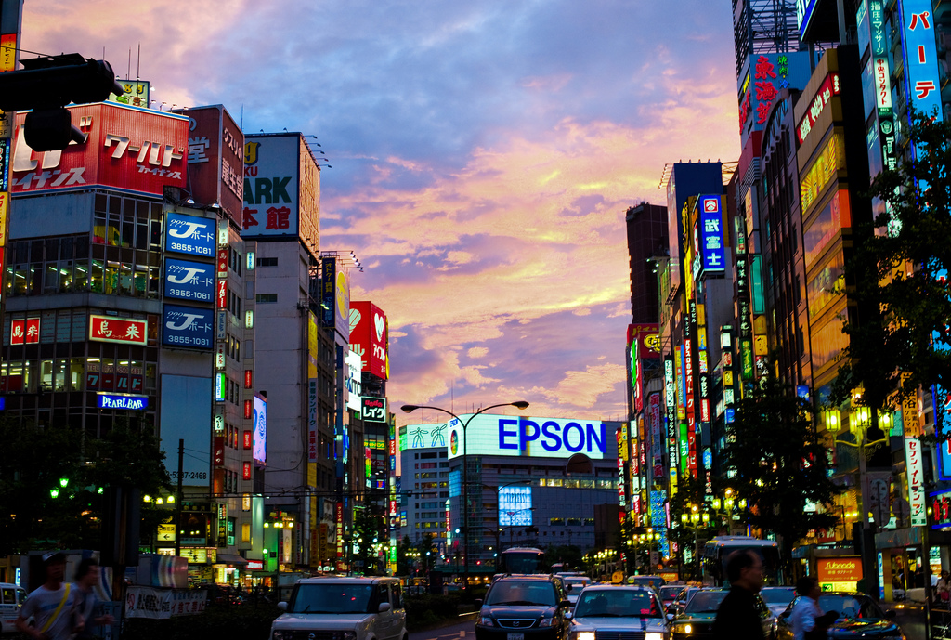
location data

Slide 10
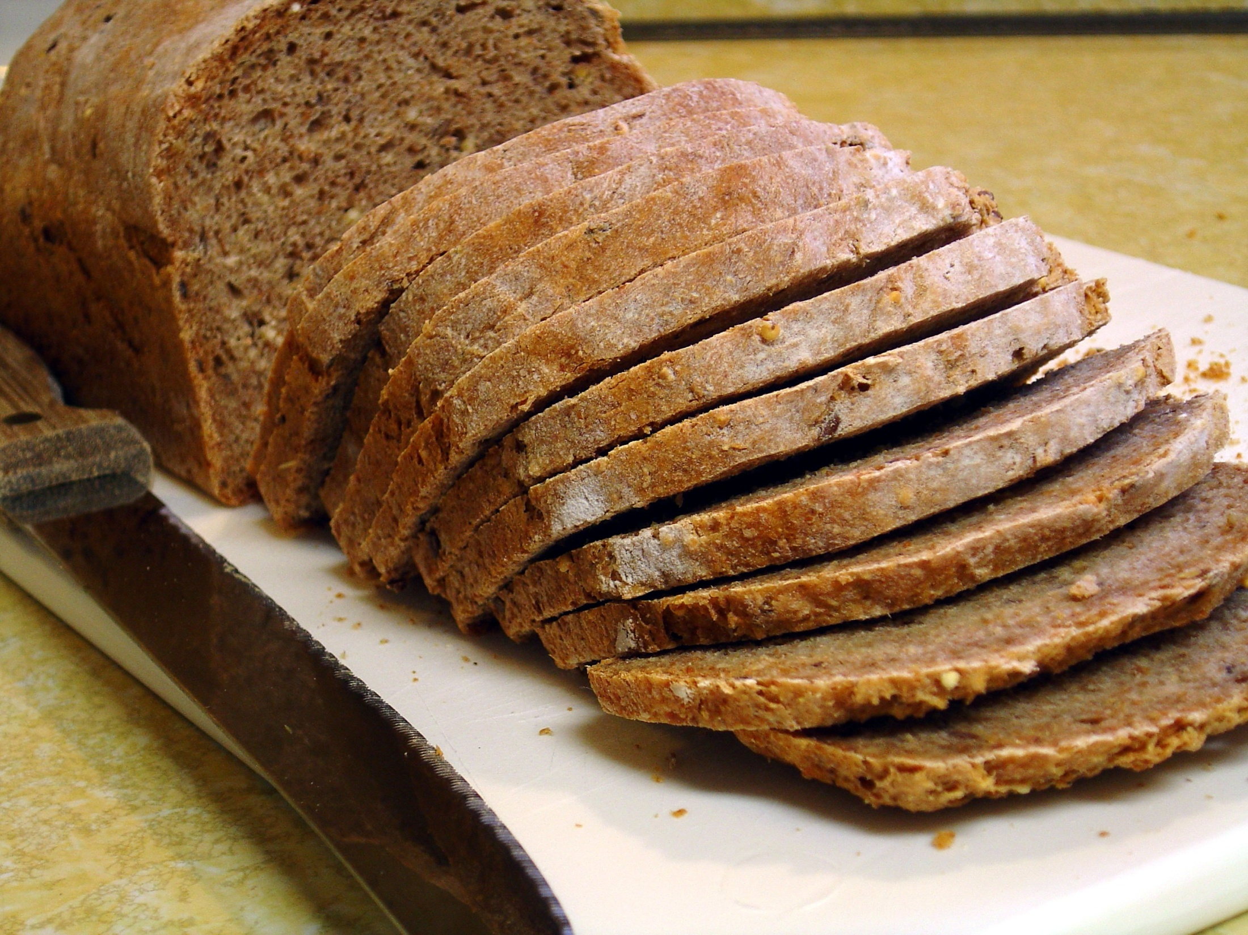
Source: flickr (60in3/2338247189)

Slide 12
Bottom Layer
Physical execution model
MapReduce
Message Passing
Shared Memory
Event processing
PubSub model
Impedance mismatch with hardware
Elasticity issues

Slide 13
Bottom Layer
Logical programming model
Graphs
Streams
Dataflows
Spatio-temporal models
Matrix operations
Complex composite workflows

Slide 14
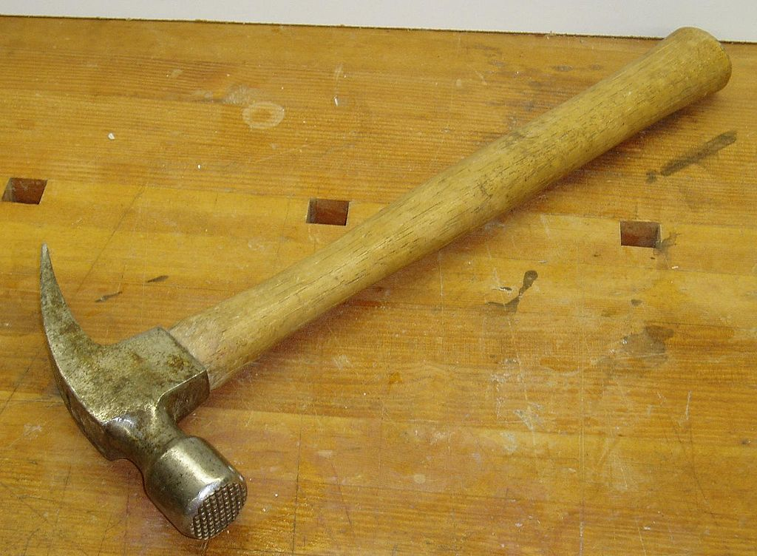

Slide 15
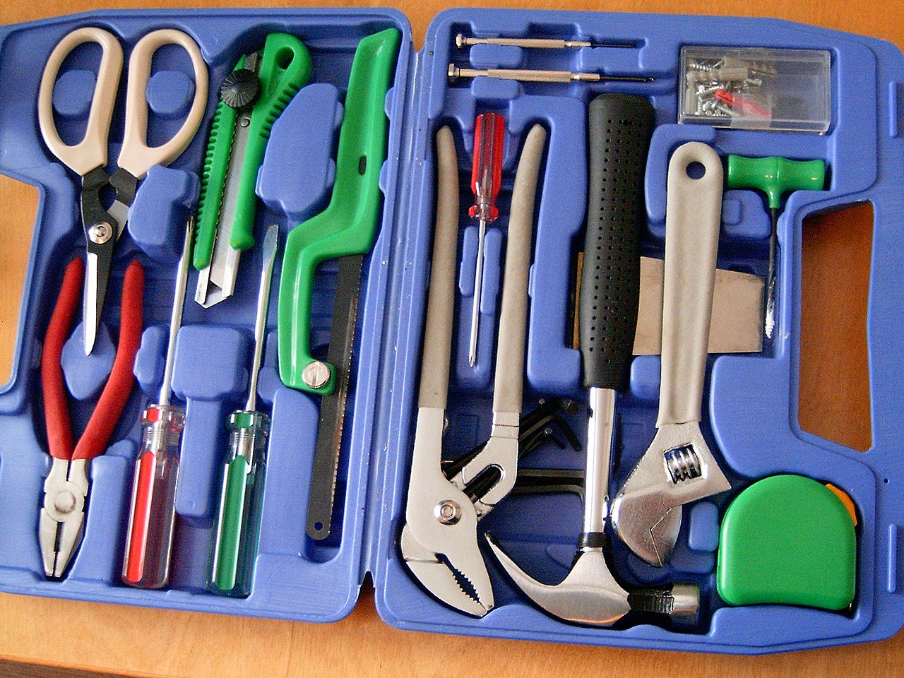

Slide 16
Middle Layer
Algorithmic issues
Batch processing vs. online/Incremental/continuous
Approximate vs. exact solutions
Synchronous vs. asynchronous

Slide 17
breaking abstractions

Slide 18
Top Layer
Applications
Data mining
Machine learning
Information Extraction
Complex event detection
Similarity searching

Slide 19
Metrics
Accuracy
Latency
Energy
Money

Slide 20
What’s special about mobile?
Resource constraints
Display/interactivity
Energy
Processing power
Bandwidth/connectivity
Interesting issues:
Mobile as sensors
Where to do computation
Novel interaction methods
Frequent disconnect operations

Slide 21
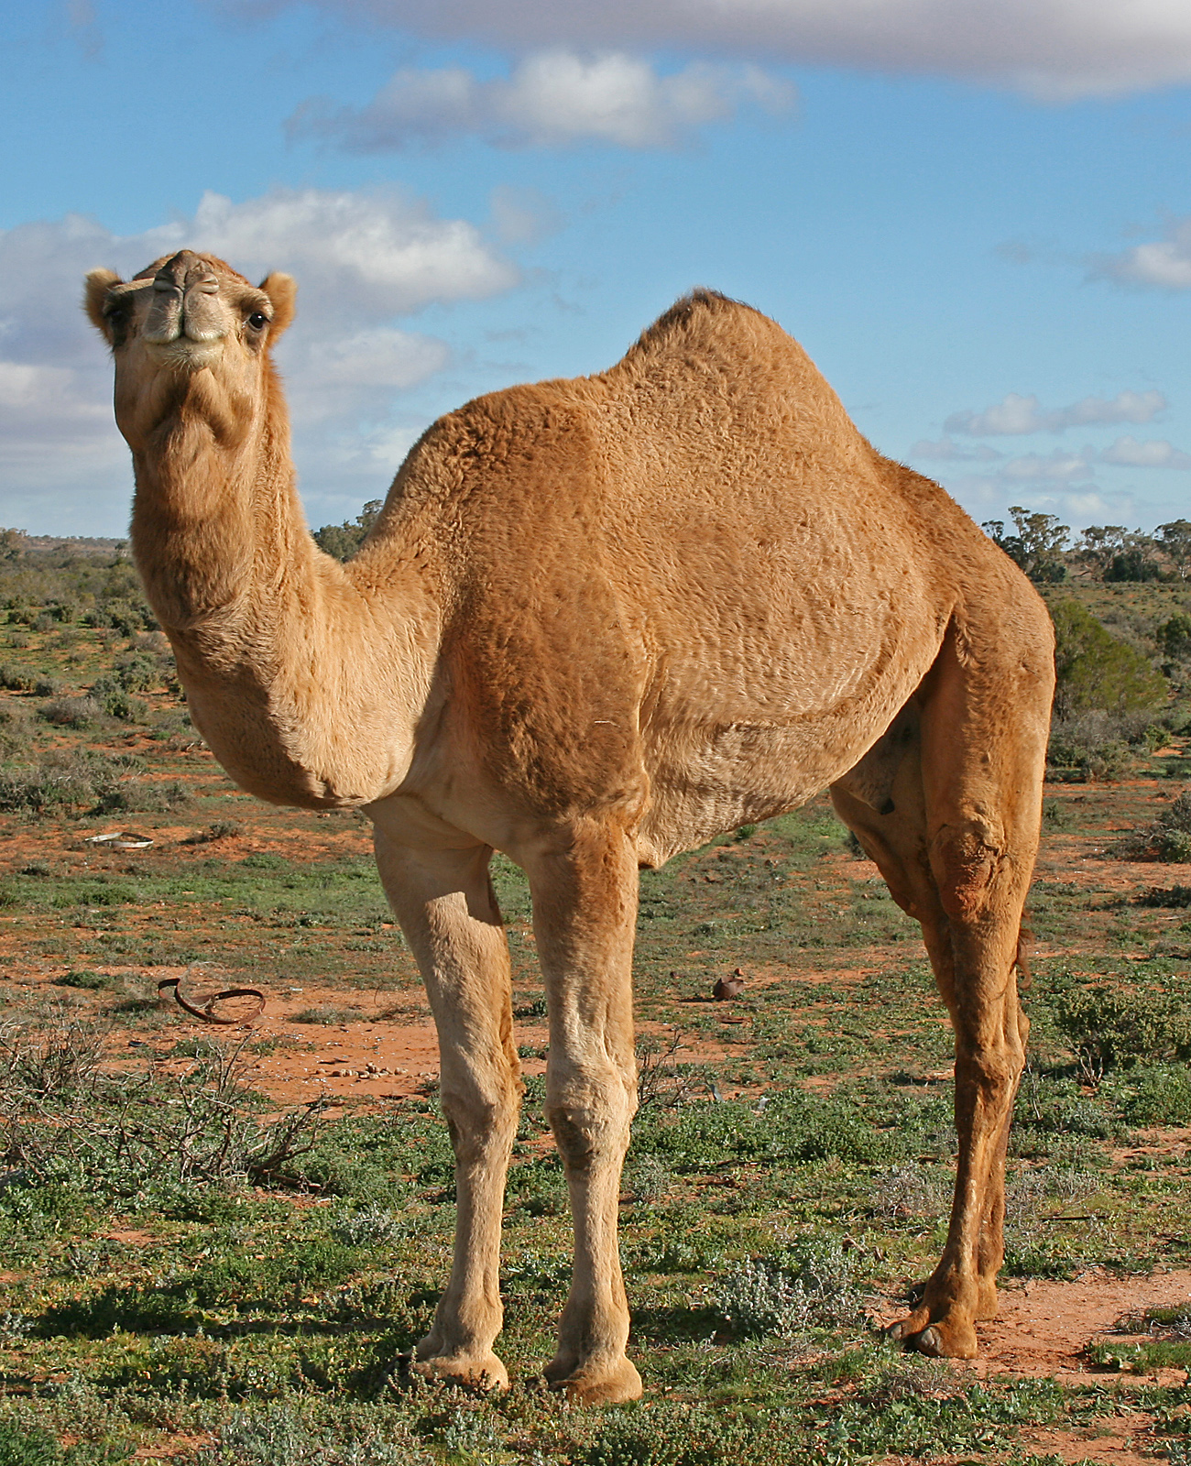

Slide 22
The Camel
Complex data mining
Massively parallel across distributed and centralized sources
On graphs and location, interaction, log data
In an online, continuous manner
Integrated with existing large data

Slide 23
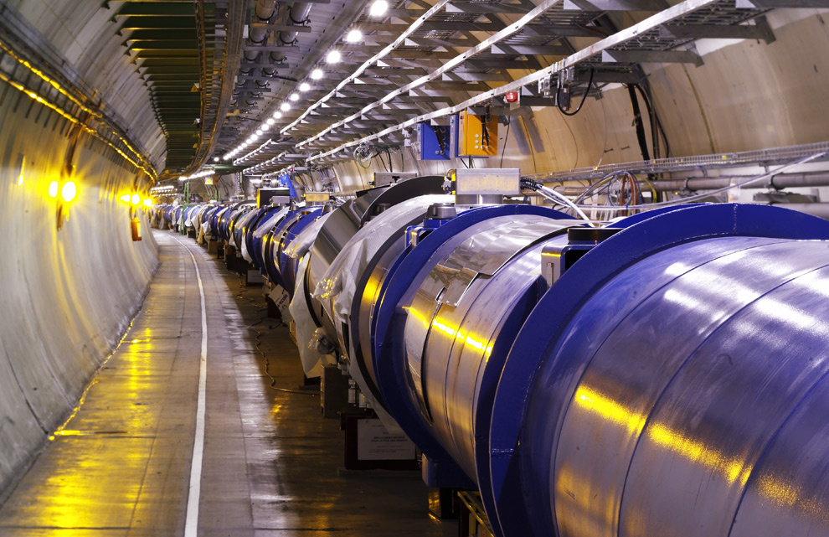
#grandchallenge
Maximilien Brice, © CERN
Notes:
By the time it shuts down in 2011, the CERN collider should have amassed about 20 times as much data as it now has. (NYTimes article, “Trillions of Reasons to Be Excited”, 11/1/2010)

