Slide 1
System Support for Managing Graphs in the Cloud
Sameh Elnikety & Yuxiong He
Microsoft Research
Notes:
?

Slide 2
Example 1 : Social Network
Scale
LinkedIn
70+ million users
Facebook
500+ million users
65+ billion photos
Rich graph
Types, attributes
Queries
Find Alice’s friends
Find Alice’s photos with friends

Slide 3
Objective: Management & Querying
Manage and query large graphs online
Today
Expensive hardware (limited)
Cluster of machines (ad-hoc)
Tomorrow
Growth area
Analogy: provide system support
Analogy: DBMS manages application data
Offers easy, efficient, reliable solution to developers

Slide 4
Key Design Decisions
Interactive queries
Graph topology stored in random access memory
Graph too large for one machine
Partitioning: slice graph into pieces
Replication: for fault tolerance
Long time to build graph
Support updates

Slide 5
A Few Research Problems
Querying the graph
Data model & query language
Execution engine
Supporting updates
Multi-version concurrency control
Partitioning
Scale-free graphs

Slide 6
Data Model
Node
ID, type, attributes
Edge
Connects two nodes
Direction, type, attributes
App
System

Slide 7
Query Language
Trade-off
Expressiveness vs. efficiency
Two query types
Reachability
Pattern matching

Slide 8
Query Language - Reachability
Regular language reachability
Query is a regular expression
Sequence of node and edge predicates
Regular predicates
Example
Alice’s photos
Photo, tags, Alice
Node: type=photo , edge: type=tags , node: type=person, name=Alice
Result: matching paths

Slide 9
Query Language - Reachability
Projection
Alice’s photos
Photo, tags, Alice
Node: type=photo , edge: type=tags , node: type=person, name=Alice
SELECT photo FROM photo, tags, Alice
OR
(Photo | video), tags, Alice
Kleene star
Alice org chart
Alice, (manages, person)*

Slide 10
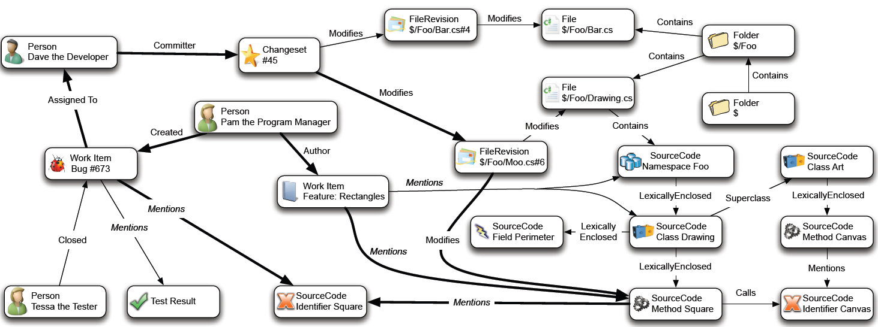
Example 2: CodeBook - Graph
Notes:
Codebook is another project at MSR, developed by the Rise group.
Graph is crawled from the TFS repository of the project. It captures the interaction at the software development.

Slide 11
Example 2: CodeBook - Queries
Person, FileOwner>, TFSFile, FileOwner<, Person
Person, DiscussionOwner>, Discussion, DiscussionOwner<, Person
Person, WorkItemOwner>, TFSWorkItem, WorkItemOwner< ,Person
Person, Manages<, Person, Manages>, Person
Person, WorkItemOwner>, TFSWorkItem, Mentions>, TFSFile, Mentions>, TFSWorkItem, WorkItemOwner<, Person
Person, WorkItemOwner>, TFSWorkItem, Mentions>, TFSFile, FileOwner<, Person
Person, FileOwner>, TFSFile, Mentions>, TFSWorkItem, Mentions>, TFSFile, FileOwner<, Person

Slide 12
Query Language – Pattern Matching
From reachability
Paths
Sequence of predicates
To graph patterns
Subgraph isomorphism
Notes:
Data center and application graphs.

Slide 13
Talk Outline
Query language
Regular language reachability
Graph pattern matching
Execution engine
Based on distributed breadth first-search
Optimizations
Supporting updates

Slide 14
Centralized Query Execution
Alice
Tags
Photo
Alice <Tags Photo
S0
S1
S2
S3
Photo Tags> Alice
Breadth First Search
Answer Paths:
Alice, Tags, Photo1 Alice, Tags, Photo8
Notes:
Observation: distributions, hybrid engines, pattern matching.

Slide 15
Cheap Concurrency Control!
Replication and partitioning
Surprising synergy
Multi-Version Concurrency Control
Generalized Snapshot Isolation
Replicas agree on
Which update transactions commit
Their commit order
Example
T1: set x = 1
T2: set x = 2
Replica1: see T1 then T2 → x= 2
Replica2: see T2 then T1 → x = 1

Slide 16
Summary
Query language
Regular language reachability
Graph pattern matching
Execution engine
Based on distributed breadth first-search
Optimizations
Supporting updates
Replication and partitioning
Multi-version concurrency models

Slide 17
A Few Research Problems
Querying the graph
Data model & query language
Execution engine
Supporting updates
Multi-version concurrency control
Partitioning
Scale-free graphs

