Slide 1
Musubi: A Mobile Social Internet
Monica Lam
MobiSocial Computing Laboratory
Stanford University
With Ben Dodson, Michael Fischer, Sudheendra Hangal,
Abhinay Nagpal, T. J. Purtell, Ian Vo
MobiSocial Lab is supported by AVG, Google, ING Direct, Nokia, Sony Ericsson.
Part of the NSF Programmable Open Mobile Internet (POMI) 2020 project.

Slide 2
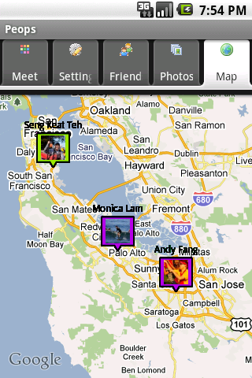
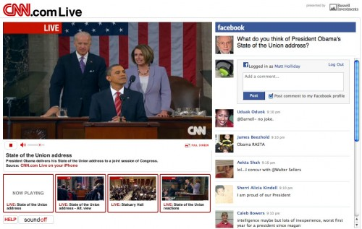
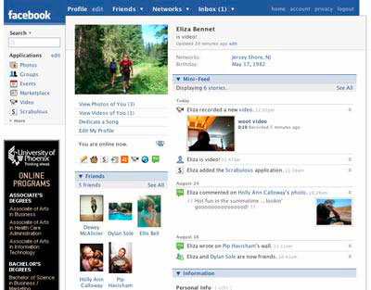
Social App Platform
FB Android SDK
Facebook Graph
800 Million Users

Slide 3
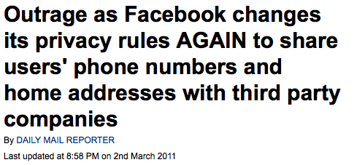
Today’s Social Intranets
Loss of privacy

Slide 4
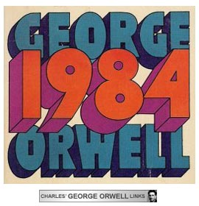
Today’s Social Intranets
Loss of privacy
Monopoly

Slide 5
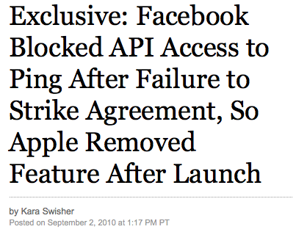
Today’s Social Intranets
Loss of privacy
Monopoly
Loss of competition
Zynga Dependency on Facebook wsj, 10-12-11

Slide 6
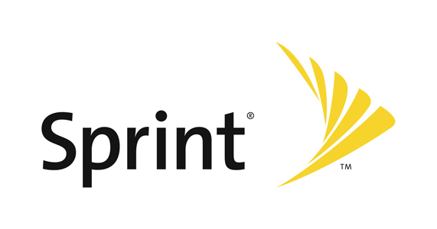
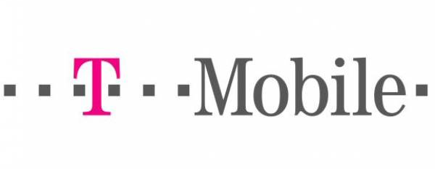
Vision: Social Intranet -> Internet
No single owner of users’ data or app platform
No need to join the same network

Slide 7
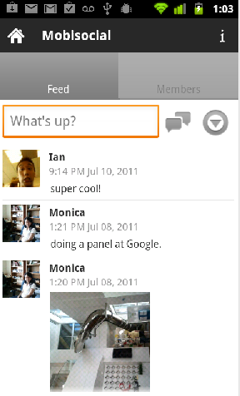
Today Social Networking
TCP/IP
Global Social Graph

Slide 8
TGCP: Disintermediation
TGCP
Trusted Group Communication Protocol
Problem 1:
Phones cannot talk to each other
→ Encrypted messages based on public keys

Slide 9
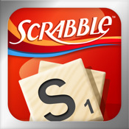
Social App Platform
TCP/IP
FB app
Global Social Graph

Slide 10
POSI: Phone-Based Open Social Interactions API
POSI
Social OS
Trusted Group Communication Protocol
Problem 2:
Global social graph
→ Decentralized graph
→ Enable decentralized apps

Slide 11
Friends = Address Book Contacts
IBE (Identity-Based Encryption)

Slide 12
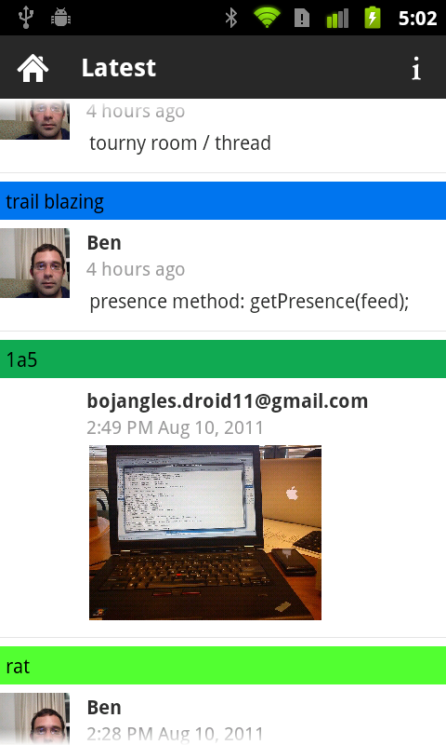
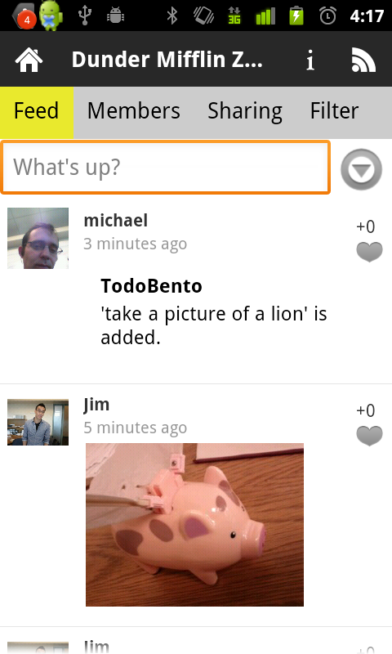
High Level View

Slide 13
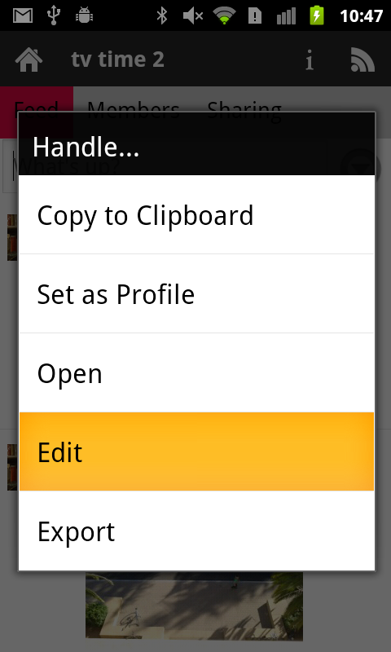
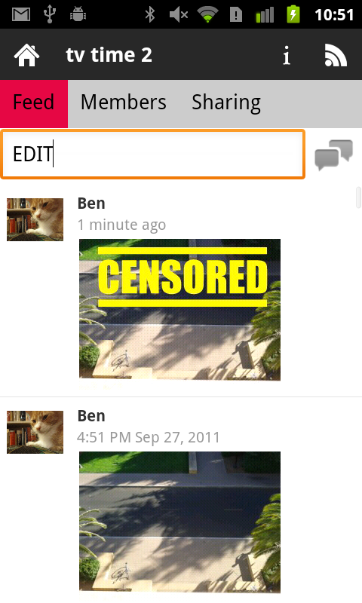
Turn existing apps social Virility: friends’ app activities

Slide 14
Starting a game

Slide 15
Joining a Game

Slide 16
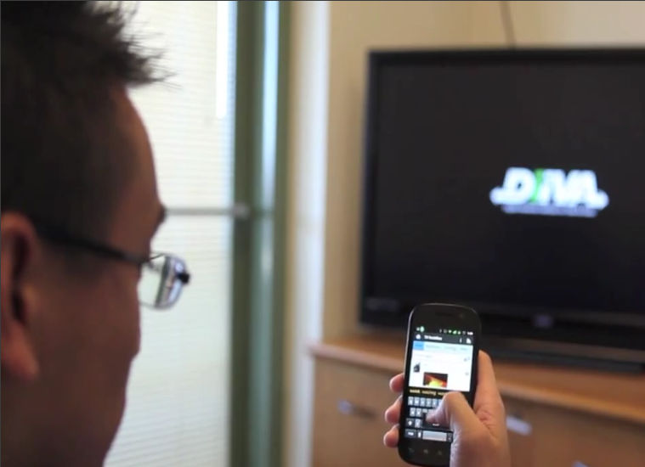
Interactive TV with Privacy

Slide 17
Musubi
Approved by 30 grade school children
“Musubi is AWESOME!”
To release in Android Market in Q2
WWW 2012

Slide 18
Privacy + Marketing Combo
Cloud Service
Device App
Lots more data!
Private Data
Private Data on Device
Use our data
to help ourselves
User Profile
User Profile
Ads
Ads
DO NOT TRACK

Slide 19
Experience-Infused Apps
Social Chatter
Names in email
Websites
Rating
Personalized Highlights in Browser [IUI 2012]
Personalized Search Engine
[CSCW 2012]

Slide 20
Research Direction
Central → Distributed
Big data → Egocentric
(more data, more cycles per person)
No privacy → Privacy (COPPA, health)
Proprietary → Open

